Slide 1
The Processor
Textbook – “David A. Patterson, John L. Hennessy, Computer Organization and Design: The hardware/software interface”
Chapter 4

Slide 2
MIPS Architecture
Introduction

Slide 3
Computer Architecture
No. of Registers
Size of Registers
Purpose of Registers
Memory Size
Instruction Set Architecture
Size of Instructions
Machine Code
Addressing Modes
Function Calls
Memory Layout
Exceptions and Interrupts
Input / Output

Slide 4
MIPS Architecture
Microprocessor without Interlocked Pipelined Stages
Reduced instruction set computer (RISC) instruction set architecture (ISA)
Developed by MIPS Computer Systems, now MIPS Technologies

Slide 5
MIPS Architecture…
No. of Registers
Size of Registers
Purpose of Registers
Memory Size
Instruction Set Architecture
Size of Instructions
Machine Code
Addressing Modes
Function Calls
Memory Layout
Exceptions and Interrupts
Input / Output

Slide 6
MIPS Architecture - Registers
MIPS CPU contains 32 general-purpose registers that are numbered 0–31.
The size of a register in the MIPS architecture is 32 bits (word)

Slide 7
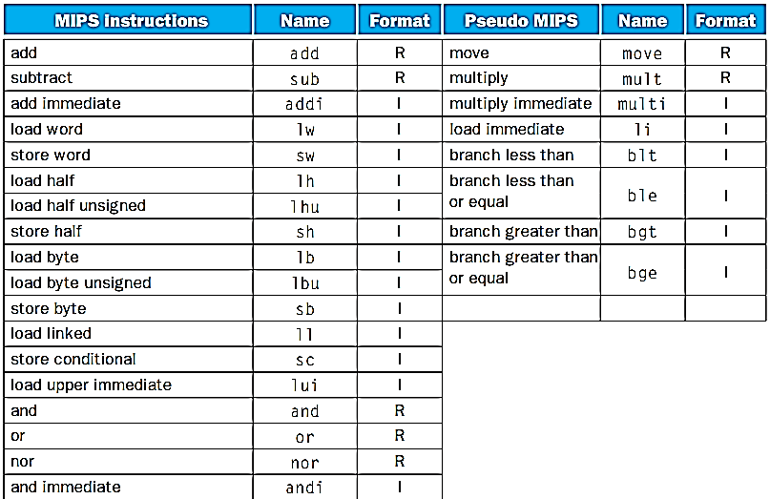
MIPS - Instruction Set
Notes:
FIGURE 2.44 The MIPS instruction set covered so far, with the real MIPS instructions on the left and the pseudoinstructions on the right. Appendix A (Section A.10) describes the full MIPS architecture. Figure 2.1 shows more details of the MIPS architecture revealed in this chapter. Th e information given here is also found in Columns 1 and 2 of the MIPS Reference Data Card at the front of the book.

Slide 8
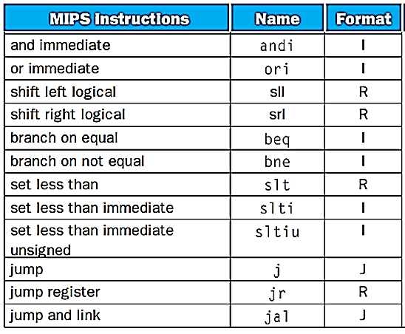
MIPS - Instruction Set
Notes:
FIGURE 2.44 The MIPS instruction set covered so far, with the real MIPS instructions on the left and the pseudoinstructions on the right. Appendix A (Section A.10) describes the full MIPS architecture. Figure 2.1 shows more details of the MIPS architecture revealed in this chapter. Th e information given here is also found in Columns 1 and 2 of the MIPS Reference Data Card at the front of the book.

Slide 9
MIPS Assembly Language – Arithmetic Instructions Example
f = (g + h) – (i + j);
MIPS Assembly Code for above code:
add $t0,$s1,$s2 # register $t0 contains g + h
add $t1,$s3,$s4 # register $t1 contains i + j
sub $s0,$t0,$t1 # f gets $t0 – $t1, which is (g + h)–(i + j)

Slide 10
MIPS Assembly Language – Load/Store Instructions Example
MIPS Assembly Code to read/write data from/to an array:
lw $t0,32($s3) # Temporary reg $t0 gets A[8]
add $t0,$s2,$t0 # Temporary reg $t0 gets h + A[8]
sw $t0,48($s3) # Stores h + A[8] back into A[12]
Load word and store word are the instructions that copy words between memory and registers in the MIPS architecture.

Slide 11
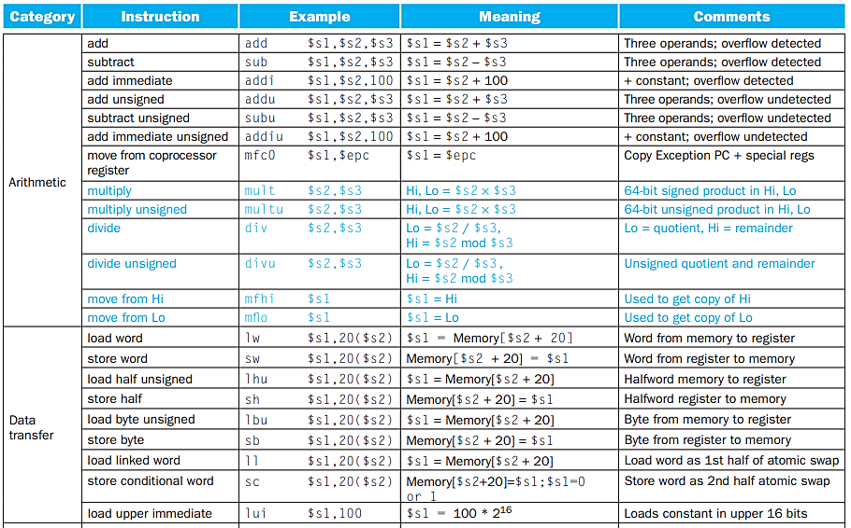
MIPS Assembly Language
Notes:
FIGURE 3.12 MIPS core architecture. Th e memory and registers of the MIPS architecture are not included for space reasons, but this section added the Hi and Lo registers to support multiply and divide. MIPS machine language is listed in the MIPS Reference Data Card at the front of this book.

Slide 12
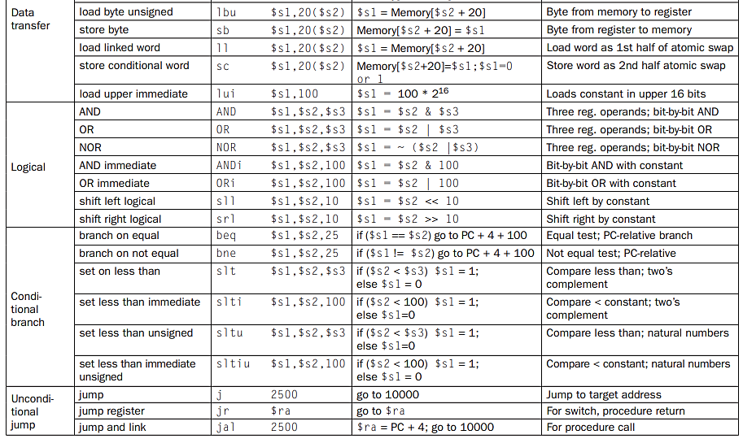
MIPS Assembly Language
Notes:
FIGURE 3.12 MIPS core architecture. Th e memory and registers of the MIPS architecture are not included for space reasons, but this section added the Hi and Lo registers to support multiply and divide. MIPS machine language is listed in the MIPS Reference Data Card at the front of this book.

Slide 13
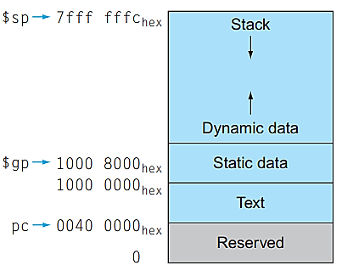
The MIPS Processor Memory Layout for program and data.
Notes:
FIGURE 2.13 The MIPS memory allocation for program and data. These addresses are only a soft ware convention, and not part of the MIPS architecture. The stack pointer is initialized to 7fff fffchex and grows down toward the data segment. At the other end, the program code (“text”) starts at 0040 0000hex. Th e static data starts at 1000 0000hex. Dynamic data, allocated by malloc in C and by new in Java, is next. It grows up toward the stack in an area called the heap. Th e global pointer, $gp, is set to an address to make it easy to access data. It is initialized to 1000 8000hex so that it can access from 1000 0000hex to 1000 ffffhex using the positive and negative 16-bit off sets from $gp. Th is information is also found in Column 4 of the MIPS Reference Data Card at the front of this book.

Slide 14
MIPS Architecture
Implementation

Slide 15
A Basic MIPS Implementation
Instruction Classes:
Arithmetic-Logical Instructions: Add, Sub, AND, OR etc.
Data-Transfer Instructions: Data Transfer Instructions, load word (lw) and store word (sw)
Branch Instructions: Branch equal (beq) and jump (j) etc
Design Problem: How can you design Instruction Fetch, consider sequential flow for now without any jump, branches and call.
Program Counter – same as IP

Slide 16
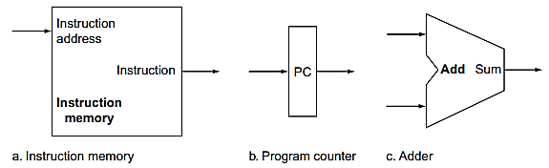
Instruction Fetch Implementation
Notes:
FIGURE 4.5 Two state elements are needed to store and access instructions, and an adder is needed to compute the next instruction address. Th e state elements are the instruction memory and the program counter. Th e instruction memory need only provide read access because the datapath does not write instructions. Since the instruction memory only reads, we treat it as combinational logic: the output at any time refl ects the contents of the location specifi ed by the address input, and no read control signal is needed. (We will need to write the instruction memory when we load the program; this is not hard to add, and we ignore it for simplicity.) Th e program counter is a 32-bit register that is written at the end of every clock cycle and thus does not need a write control signal. Th e adder is an ALU wired to always add its two 32-bit inputs and place the sum on its output.

Slide 17
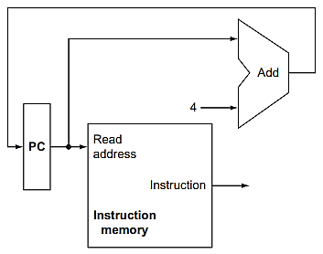
Instruction Fetch Implementation…
Question:
Exactly when the PC will be updated?
Notes:
FIGURE 4.6 A portion of the datapath used for fetching instructions and incrementing the program counter. Th e fetched instruction is used by other parts of the datapath.

Slide 18
Instruction Fetch Implementation…
Answer:
PC will be updated at every positive edge of clock cycle.
Notes:
FIGURE 4.6 A portion of the datapath used for fetching instructions and incrementing the program counter. Th e fetched instruction is used by other parts of the datapath.

Slide 19
Operation of Datapath on Arithmetic/Logical Instructions

Slide 20
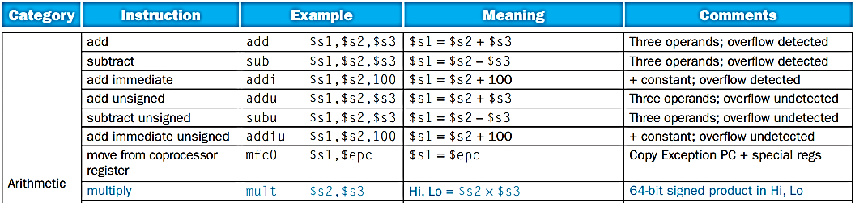
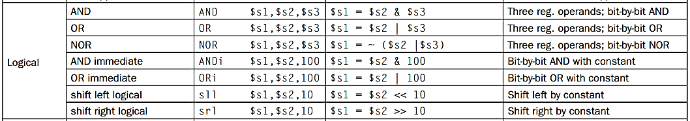
Arithmetic/Logical (R-Type) Instructions Examples
Notes:
FIGURE 3.12 MIPS core architecture. Th e memory and registers of the MIPS architecture are not included for space reasons, but this section added the Hi and Lo registers to support multiply and divide. MIPS machine language is listed in the MIPS Reference Data Card at the front of this book.

Slide 21
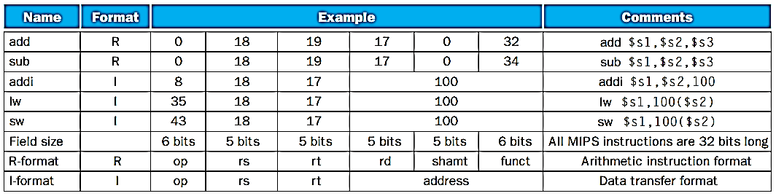

Arithmetic/Logical (R-Type) Instructions Examples
Different Field values for
Add $s1, $s2, $s3
0
18
19
17
0
32
Notes:
FIGURE 2.6 MIPS architecture revealed through Section 2.5. Th e two MIPS instruction formats so far are R and I. Th e fi rst 16 bits are the same: both contain an op fi eld, giving the base operation; an rs fi eld, giving one of the sources; and the rt fi eld, which specifi es the other source operand, except for load word, where it specifi es the destination register. R-format divides the last 16 bits into an rd fi eld, specifying the destination register; the shamt fi eld, which Section 2.6 explains; and the funct fi eld, which specifi es the specifi c operation of R-format instructions. I-format combines the last 16 bits into a single address fi eld.

Slide 22
Arithmetic/Logical (I-Type) Instructions Examples
Notes:
FIGURE 3.12 MIPS core architecture. Th e memory and registers of the MIPS architecture are not included for space reasons, but this section added the Hi and Lo registers to support multiply and divide. MIPS machine language is listed in the MIPS Reference Data Card at the front of this book.

Slide 23

Arithmetic/Logical (I-Type) Instructions Examples
Different Field values for
Addi $s1, $s2, 100
8
18
17
100
Notes:
FIGURE 2.6 MIPS architecture revealed through Section 2.5. Th e two MIPS instruction formats so far are R and I. Th e fi rst 16 bits are the same: both contain an op fi eld, giving the base operation; an rs fi eld, giving one of the sources; and the rt fi eld, which specifi es the other source operand, except for load word, where it specifi es the destination register. R-format divides the last 16 bits into an rd fi eld, specifying the destination register; the shamt fi eld, which Section 2.6 explains; and the funct fi eld, which specifi es the specifi c operation of R-format instructions. I-format combines the last 16 bits into a single address fi eld.

Slide 24
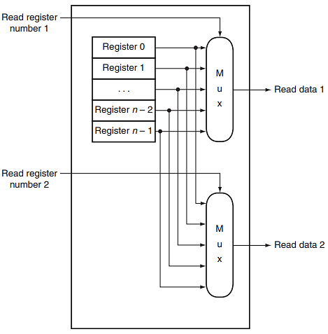

Read Ports of Register File
For Example:
add $s1,$s2,$s3
$s1 = $s2 + $s3
$s2
Notes:
FIGURE B.8.8 The implementation of two read ports for a register fi le with n registers can be done with a pair of n-to-1 multiplexors, each 32 bits wide. Th e register read number signal is used as the multiplexor selector signal. Figure B.8.9 shows how the write port is implemented.

Slide 25
Read Ports of Register File
For Example:
add $s1,$s2,$s3
$s1 = $s2 + $s3
$s2
$s3
Notes:
FIGURE B.8.8 The implementation of two read ports for a register fi le with n registers can be done with a pair of n-to-1 multiplexors, each 32 bits wide. Th e register read number signal is used as the multiplexor selector signal. Figure B.8.9 shows how the write port is implemented.

Slide 26
Read Ports of Register File
For Example:
add $s1,$s2,$s3
$s1 = $s2 + $s3
$s2
$s3
Notes:
FIGURE B.8.8 The implementation of two read ports for a register fi le with n registers can be done with a pair of n-to-1 multiplexors, each 32 bits wide. Th e register read number signal is used as the multiplexor selector signal. Figure B.8.9 shows how the write port is implemented.

Slide 27
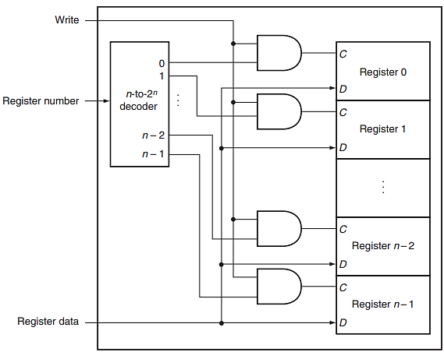
Write Port for Register File
For Example:
add $s1,$s2,$s3
$s1 = $s2 + $s3
$s1
Notes:
FIGURE B.8.9 The write port for a register fi le is implemented with a decoder that is used with the write signal to generate the C input to the registers. All three inputs (the register number, the data, and the write signal) will have setup and hold-time constraints that ensure that the correct data is written into the register fi le.

Slide 28
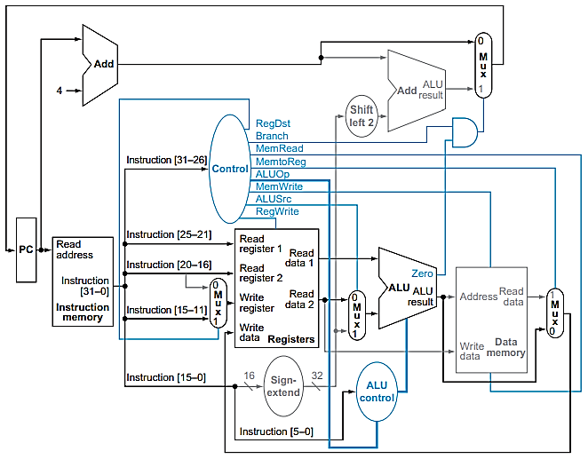

Operation of Datapath for an R-Type Instruction
For Example:
add $s1,$s2,$s3
$s1 = $s2 + $s3
0
18
19
17
0
32
Notes:
FIGURE 4.19 The datapath in operation for an R-type instruction, such as add $t1,$t2,$t3. Th e control lines, datapath units, and connections that are active are highlighted.

Slide 29
Operation of Datapath for an R-Type Instruction
For Example:
add $s1,$s2,$s3
$s1 = $s2 + $s3
0
18
19
17
0
32
Notes:
FIGURE 4.19 The datapath in operation for an R-type instruction, such as add $t1,$t2,$t3. Th e control lines, datapath units, and connections that are active are highlighted.

Slide 30
Operation of Datapath for an R-Type Instruction
For Example:
add $s1,$s2,$s3
$s1 = $s2 + $s3
0
18
19
17
0
32
Notes:
FIGURE 4.19 The datapath in operation for an R-type instruction, such as add $t1,$t2,$t3. Th e control lines, datapath units, and connections that are active are highlighted.

Slide 31

Operation of Datapath for an R-Type Instruction
18
For Example:
add $s1,$s2,$s3
$s1 = $s2 + $s3
0
18
19
17
0
32
Notes:
FIGURE 4.19 The datapath in operation for an R-type instruction, such as add $t1,$t2,$t3. Th e control lines, datapath units, and connections that are active are highlighted.

Slide 32
Operation of Datapath for an R-Type Instruction
For Example:
add $s1,$s2,$s3
$s1 = $s2 + $s3
19
0
18
19
17
0
32
Notes:
FIGURE 4.19 The datapath in operation for an R-type instruction, such as add $t1,$t2,$t3. Th e control lines, datapath units, and connections that are active are highlighted.

Slide 33
Operation of Datapath for an R-Type Instruction
For Example:
add $s1,$s2,$s3
$s1 = $s2 + $s3
How can we send $s3’s data to ALU 2nd Operand?
0
18
19
17
0
32
Notes:
FIGURE 4.19 The datapath in operation for an R-type instruction, such as add $t1,$t2,$t3. Th e control lines, datapath units, and connections that are active are highlighted.

Slide 34
Operation of Datapath for an R-Type Instruction
For Example:
add $s1,$s2,$s3
$s1 = $s2 + $s3
ALUSrc = 0
0
18
19
17
0
32
Notes:
FIGURE 4.19 The datapath in operation for an R-type instruction, such as add $t1,$t2,$t3. Th e control lines, datapath units, and connections that are active are highlighted.

Slide 35
Operation of Datapath for an R-Type Instruction
ALUSrc = 0
For Example:
add $s1,$s2,$s3
$s1 = $s2 + $s3
ALUSrc = 0
What will happen if ALUSrc = 1?
0
18
19
17
0
32
Notes:
FIGURE 4.19 The datapath in operation for an R-type instruction, such as add $t1,$t2,$t3. Th e control lines, datapath units, and connections that are active are highlighted.

Slide 36
Operation of Datapath for an R-Type Instruction
For Example:
add $s1,$s2,$s3
$s1 = $s2 + $s3
ALUSrc = 0
What exact values are coming at MUX line 1?
0
18
19
17
0
32
Notes:
FIGURE 4.19 The datapath in operation for an R-type instruction, such as add $t1,$t2,$t3. Th e control lines, datapath units, and connections that are active are highlighted.

Slide 37
Operation of Datapath for an R-Type Instruction
For Example:
add $s1,$s2,$s3
$s1 = $s2 + $s3
How can we send this ALUResult to write to $s1?
0
18
19
17
0
32
Notes:
FIGURE 4.19 The datapath in operation for an R-type instruction, such as add $t1,$t2,$t3. Th e control lines, datapath units, and connections that are active are highlighted.

Slide 38
Operation of Datapath for an R-Type Instruction
MemtoReg = 0
For Example:
add $s1,$s2,$s3
$s1 = $s2 + $s3
MemtoReg = 0
0
18
19
17
0
32
Notes:
FIGURE 4.19 The datapath in operation for an R-type instruction, such as add $t1,$t2,$t3. Th e control lines, datapath units, and connections that are active are highlighted.

Slide 39
Operation of Datapath for an R-Type Instruction
For Example:
add $s1,$s2,$s3
$s1 = $s2 + $s3
MemtoReg = 0
What will happen if MemtoReg = 1?
0
18
19
17
0
32
Notes:
FIGURE 4.19 The datapath in operation for an R-type instruction, such as add $t1,$t2,$t3. Th e control lines, datapath units, and connections that are active are highlighted.

Slide 40
Operation of Datapath for an R-Type Instruction
For Example:
add $s1,$s2,$s3
$s1 = $s2 + $s3
At this moment,
What exactly is happening in Data Memory block?
What control signal it needs to read/write?
What data it will write and at which address?
What will be the content of ReadData line?
0
18
19
17
0
32
Notes:
FIGURE 4.19 The datapath in operation for an R-type instruction, such as add $t1,$t2,$t3. Th e control lines, datapath units, and connections that are active are highlighted.

Slide 41
Operation of Datapath for an R-Type Instruction
For Example:
add $s1,$s2,$s3
$s1 = $s2 + $s3
19
0
18
19
17
0
32
Notes:
FIGURE 4.19 The datapath in operation for an R-type instruction, such as add $t1,$t2,$t3. Th e control lines, datapath units, and connections that are active are highlighted.

Slide 42
Operation of Datapath for an R-Type Instruction
For Example:
add $s1,$s2,$s3
$s1 = $s2 + $s3
19
At this moment,
What is the content of this line
0
18
19
17
0
32
Notes:
FIGURE 4.19 The datapath in operation for an R-type instruction, such as add $t1,$t2,$t3. Th e control lines, datapath units, and connections that are active are highlighted.

Slide 43
Operation of Datapath for an R-Type Instruction
For Example:
add $s1,$s2,$s3
$s1 = $s2 + $s3
RegDest = 1
0
18
19
17
0
32
Notes:
FIGURE 4.19 The datapath in operation for an R-type instruction, such as add $t1,$t2,$t3. Th e control lines, datapath units, and connections that are active are highlighted.

Slide 44
Operation of Datapath for an R-Type Instruction
RegDest = 1
For Example:
add $s1,$s2,$s3
$s1 = $s2 + $s3
RegDest = 1
What exactly will happen if RegDest = 0?
0
18
19
17
0
32
Notes:
FIGURE 4.19 The datapath in operation for an R-type instruction, such as add $t1,$t2,$t3. Th e control lines, datapath units, and connections that are active are highlighted.

Slide 45
Arithmetic/Logical (I-Type) Instructions Examples
Notes:
FIGURE 3.12 MIPS core architecture. Th e memory and registers of the MIPS architecture are not included for space reasons, but this section added the Hi and Lo registers to support multiply and divide. MIPS machine language is listed in the MIPS Reference Data Card at the front of this book.

Slide 46
Arithmetic/Logical (I-Type) Instructions Examples
Different Field values for
Addi $s1, $s2, 100
8
18
17
100
Notes:
FIGURE 2.6 MIPS architecture revealed through Section 2.5. Th e two MIPS instruction formats so far are R and I. Th e fi rst 16 bits are the same: both contain an op fi eld, giving the base operation; an rs fi eld, giving one of the sources; and the rt fi eld, which specifi es the other source operand, except for load word, where it specifi es the destination register. R-format divides the last 16 bits into an rd fi eld, specifying the destination register; the shamt fi eld, which Section 2.6 explains; and the funct fi eld, which specifi es the specifi c operation of R-format instructions. I-format combines the last 16 bits into a single address fi eld.

Slide 47
Operation of Datapath for an I-Type Instruction
For Example:
addi $s1,$s2,100
$s1 = $s2 + 100
8
18
17
100

Slide 48
Operation of Datapath for an I-Type Instruction
18
For Example:
addi $s1,$s2,100
$s1 = $s2 + 100
Immediate
8
18
17
100

Slide 49
Operation of Datapath for an I-Type Instruction
For Example:
addi $s1,$s2,100
$s1 = $s2 + 100
100
100
Immediate
8
18
17
100

Slide 50
Operation of Datapath for an I-Type Instruction
ALUSrc = 1
For Example:
addi $s1,$s2,100
$s1 = $s2 + 100
100
Immediate
8
18
17
100

Slide 51
Operation of Datapath for an I-Type Instruction
MemtoReg = 0
For Example:
addi $s1,$s2,100
$s1 = $s2 + 100
Immediate
8
18
17
100

Slide 52
Operation of Datapath for an I-Type Instruction
RegDest = 0
For Example:
addi $s1,$s2,100
$s1 = $s2 + 100
17
Immediate
8
18
17
100

Slide 53
Operation of Datapath for an Arithmetic/ Logical Instruction
The instruction is fetched, and the PC is incremented.
Two registers, $t2 and $t3, are read from the register file; also, the main control unit computes the setting of the control lines during this step.
The ALU operates on the data read from the register file, using the function code (bits 5:0, which is the funct field, of the instruction) to generate the ALU function.
The result from the ALU is written into the register file using bits 15:11 of the instruction to select the destination register ($t1).
For Example:
add $t1,$t2,$t3

Slide 54
Operation of Datapath on Data Transfer Instructions

Slide 55
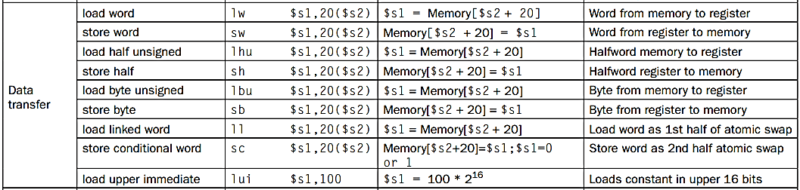
Load/Store Instructions Examples
Notes:
FIGURE 3.12 MIPS core architecture. Th e memory and registers of the MIPS architecture are not included for space reasons, but this section added the Hi and Lo registers to support multiply and divide. MIPS machine language is listed in the MIPS Reference Data Card at the front of this book.

Slide 56
Load/Store Instructions Format
Different Field values for
lw $s1, 100($s2)
sw $s1, 100($s2)
35
18
17
100
43
18
17
100
Notes:
FIGURE 2.6 MIPS architecture revealed through Section 2.5. Th e two MIPS instruction formats so far are R and I. Th e fi rst 16 bits are the same: both contain an op fi eld, giving the base operation; an rs fi eld, giving one of the sources; and the rt fi eld, which specifi es the other source operand, except for load word, where it specifi es the destination register. R-format divides the last 16 bits into an rd fi eld, specifying the destination register; the shamt fi eld, which Section 2.6 explains; and the funct fi eld, which specifi es the specifi c operation of R-format instructions. I-format combines the last 16 bits into a single address fi eld.

Slide 57
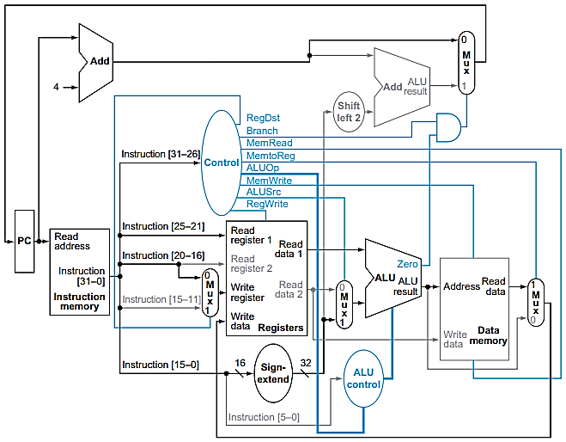

Operation of Datapath for a Load Instruction
For Example:
lw $s1, 100($s2)
18
35
18
17
100

Slide 58
Operation of Datapath for a Load Instruction
For Example:
lw $s1, 100($s2)
ALUSrc = 1
ALUSrc = 1
100
35
18
17
100

Slide 59
Operation of Datapath for a Load Instruction
For Example:
lw $s1, 100($s2)
35
18
17
100

Slide 60
Operation of Datapath for a Load Instruction
For Example:
lw $s1, 100($s2)
MemRead = 1
35
18
17
100

Slide 61
Operation of Datapath for a Load Instruction
MemtoReg = 1
For Example:
lw $s1, 100($s2)
MemtoReg = 1
35
18
17
100

Slide 62
Operation of Datapath for a Load Instruction
RegDest = 0
For Example:
lw $s1, 100($s2)
17
RegDet = 0
35
18
17
100

Slide 63
Store Instructions Format
Different Field values for
sw $s1, 100($s2)
43
18
17
100
Notes:
FIGURE 2.6 MIPS architecture revealed through Section 2.5. Th e two MIPS instruction formats so far are R and I. Th e fi rst 16 bits are the same: both contain an op fi eld, giving the base operation; an rs fi eld, giving one of the sources; and the rt fi eld, which specifi es the other source operand, except for load word, where it specifi es the destination register. R-format divides the last 16 bits into an rd fi eld, specifying the destination register; the shamt fi eld, which Section 2.6 explains; and the funct fi eld, which specifi es the specifi c operation of R-format instructions. I-format combines the last 16 bits into a single address fi eld.

Slide 64
Operation of Datapath for a Store Instruction
For Example:
sw $s1, 100($s2)
18
43
18
17
100

Slide 65
Operation of Datapath for a Store Instruction
For Example:
sw $s1, 100($s2)
ALUSrc = 1
100
43
18
17
100

Slide 66
Operation of Datapath for a Store Instruction
For Example:
sw $s1, 100($s2)
43
18
17
100

Slide 67
Operation of Datapath for a Store Instruction
For Example:
sw $s1, 100($s2)
17
43
18
17
100

Slide 68
Operation of Datapath for a Store Instruction
For Example:
sw $s1, 100($s2)
17
43
18
17
100

Slide 69
Operation of Datapath for a Store Instruction
MemWrite = 1
For Example:
sw $s1, 100($s2)
MemWrite = 1
43
18
17
100

Slide 70
Operation of Datapath for a Load Instruction
An instruction is fetched from the instruction memory, and the PC is incremented.
A register ($t2) value is read from the register file.
The ALU computes the sum of the value read from the register file and the sign-extended, lower 16 bits of the instruction (offset).
The sum from the ALU is used as the address for the data memory.
The data from the memory unit is written into the register file; the register destination is given by bits 20:16 of the instruction ($t1).
For Example:
lw $t1, offset($t2)

Slide 71
Operation of Datapath on Branch Instructions

Slide 72
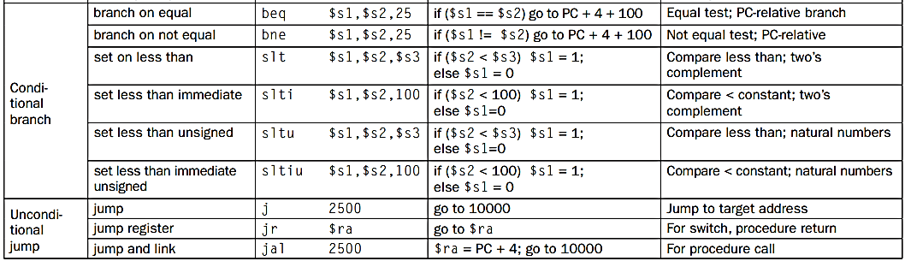

Branch Instructions Examples
17
18
25
Notes:
FIGURE 3.12 MIPS core architecture. Th e memory and registers of the MIPS architecture are not included for space reasons, but this section added the Hi and Lo registers to support multiply and divide. MIPS machine language is listed in the MIPS Reference Data Card at the front of this book.

Slide 73
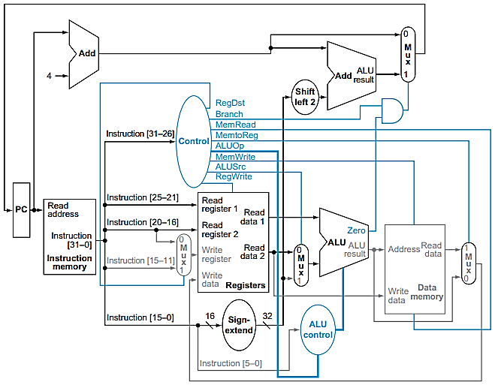

Operation of Datapath for a Branch Instruction
For Example:
Beq Reg1, Reg2, offset
beq $s1, $s2, 25
Goto PC+4+100
17
18
17
18
25

Slide 74
Operation of Datapath for a Branch Instruction
For Example:
Beq Reg1, Reg2, offset
beq $s1, $s2, 25
Goto PC+4+100
ALUSrc = 0
17
18
25

Slide 75
Operation of Datapath for a Branch Instruction
Branch
Taken
For Example:
Beq Reg1, Reg2, offset
beq $s1, $s2, 25
Goto PC+4+100
Branch = 1
17
18
25

Slide 76
Operation of Datapath for a Branch Instruction
Branch
Taken
For Example:
Beq Reg1, Reg2, offset
beq $s1, $s2, 25
Goto PC+4+100
Branch = 1
25
17
18
25

Slide 77
Operation of Datapath for a Branch Instruction
PC+4
Branch
Taken
For Example:
Beq Reg1, Reg2, offset
beq $s1, $s2, 25
Goto PC+4+100
Branch = 1
17
18
25

Slide 78
Operation of Datapath for a Branch Instruction
PC+4
Branch
Taken
For Example:
Beq Reg1, Reg2, offset
beq $s1, $s2, 25
Goto PC+4+100
17
18
25

Slide 79
Operation of Datapath for a Branch Instruction
PC+4
Branch
Not
Taken
For Example:
Beq Reg1, Reg2, offset
beq $s1, $s2, 25
Goto PC+4+100
17
18
25

Slide 80
Datapath Design – MIPS Implementation
PC+4
- Datapath VS Control Unit
- Can you design Control Unit?

Slide 81
Operation of Datapath for a Branch Instruction
An instruction is fetched from the instruction memory, and the PC is incremented.
Two registers, $t1 and $t2, are read from the register file.
The ALU performs a subtract on the data values read from the register file. The value of PC + 4 is added to the sign-extended, lower 16 bits of the instruction (offset) shifted left by two; the result is the branch target address.
The Zero result from the ALU is used to decide which adder result to store into the PC.
For Example:
beq $t1, $t2, offset

Slide 82
An overview of Implementation
Instruction Fetch:
Send the Program Counter (PC) to the memory that contains the code
fetch the instruction from that memory
Read Register:
Read one or two registers, using fields of the instruction to select the registers to read.
For the load word instruction, we need to read only one register
most other instructions require reading two registers
Use Arithmetic-Logical Unit (ALU):
The memory-reference instructions use the ALU for an address calculation
the arithmetic-logical instructions use the ALU for the operation execution
branches use the ALU for comparison

Slide 83
An overview of Implementation
Step 4:
Date Access: A memory-reference instruction will need to access the memory either to read data for a load or write data for a store.
Register Write: An arithmetic-logical or load instruction must write the data from the ALU or memory back into a register.
Update PC: for a branch instruction, we may need to change the next instruction address based on the comparison; otherwise, the PC should be incremented by 4 to get the address of the next instruction.

Slide 84
Reading Assignment
Chapter 4 – The Processor (up to section 4.4)
Datapath to handle Unconditional Jump Instruction

